Slide 1

Expensing & Depreciation Strategies To Counter Upcoming Tax Increases Unlock Cash Flow for Building Owner Clients or Tenant Owned Spaces
Notes:
Jerry Intro - Thank the Society - and YOU for ATTENDING - Blessed to be here today

Slide 2
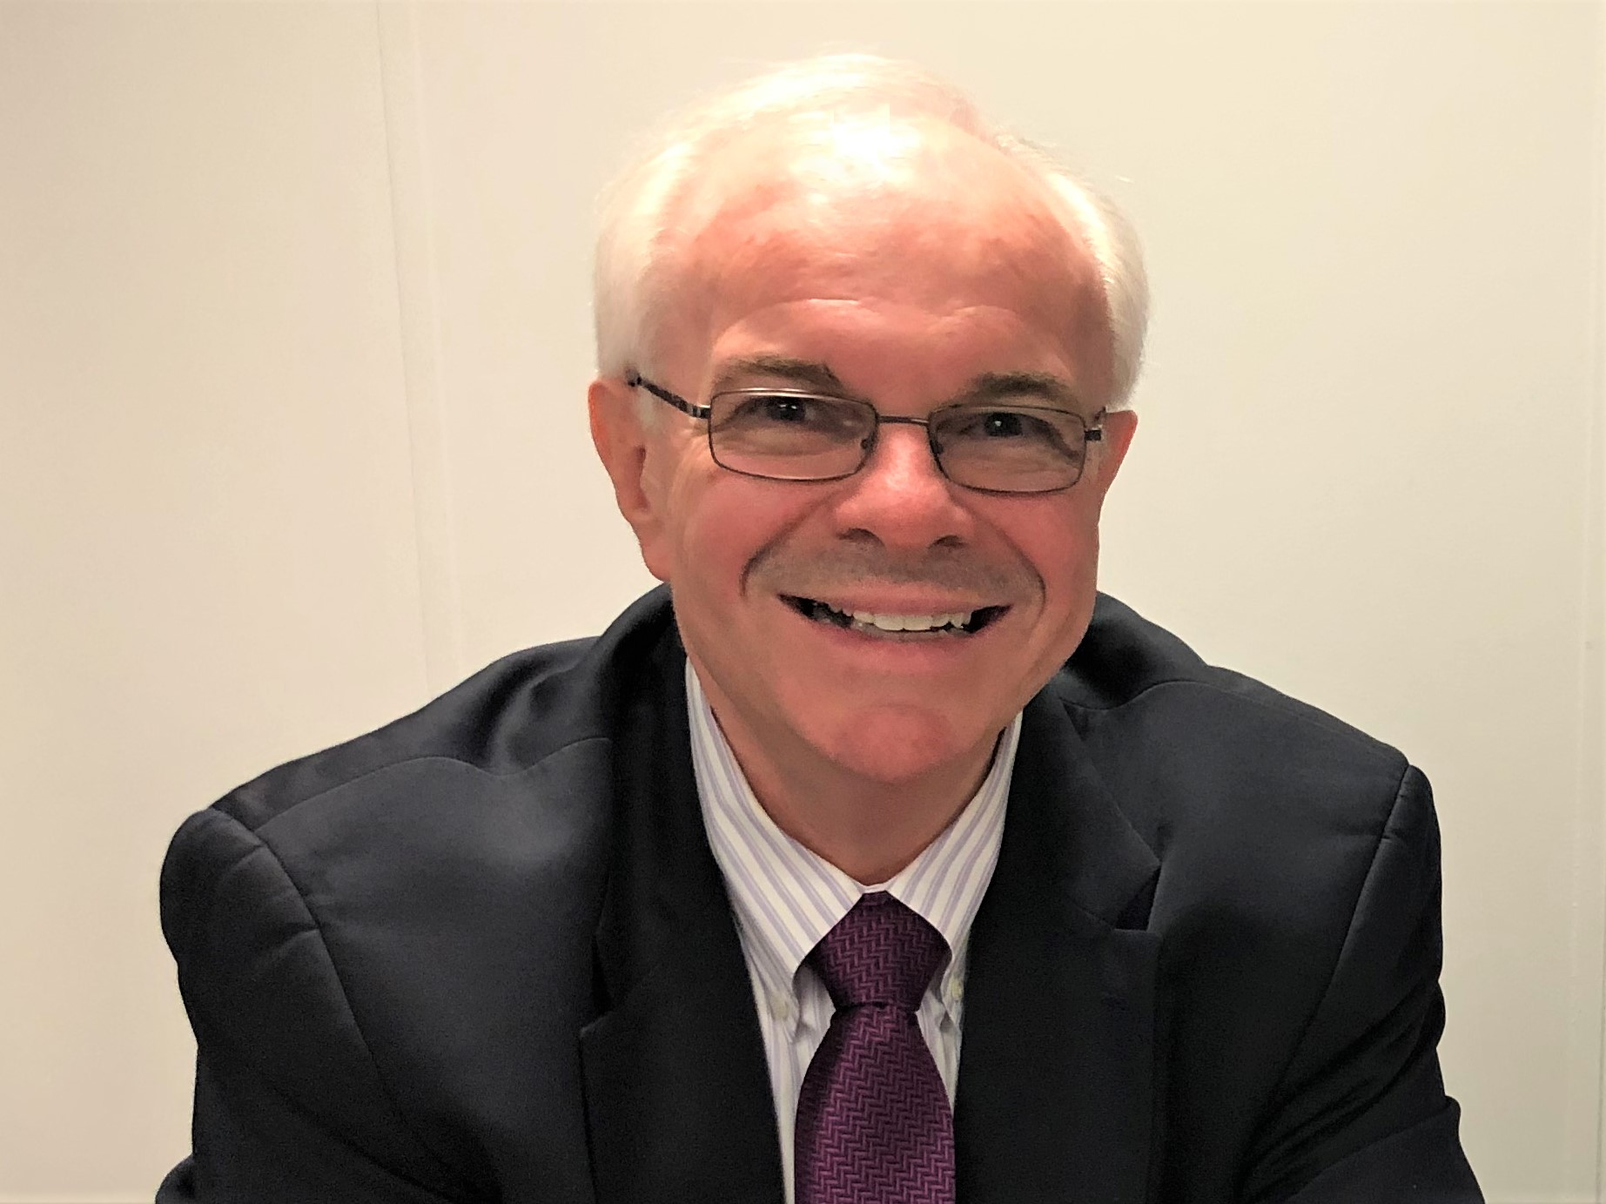
Jerry Lotz
Savings Advisor
CostSeg Energy Solutions
410.960.8269
jlotz@costseges.com
Jerry is a Baltimore native and holds a business degree from Towson University. He spent thirty years in various managerial positions in the medical sales industry. An entrepreneur at heart, six years ago Jerry launched CostSeg Energy Solutions. CostSeg Energy Solutions represents a few “Best-in-Class” companies whose mission is to help income producing property owners, leaseholders, for profit and not-for-profit organizations, as well as consumers, to save money in areas in which they spend money.
Jerry is a National Savings Advisor for Cost Segregation Services, Inc., (CSSI). He helps tax professionals and their clients to comply with the latest regulations and save taxes. He is also a licensed Life Insurance Producer.
When Jerry is not working, he enjoys spending time with his wife, children, and grandchildren. He believes that “Friends Don’t Let Friends Overpay for ANYTHING!”
Notes:
Jerry - Opportunity to work with PSTAP

Slide 3

Warren Dazzio
Executive Vice President
CSSI – Cost Segregation Services, Inc.
225.241.9823
dazziow@costsegserve.com
Warren Dazzio serves as Executive Vice President of CSSI. He has extensive knowledge of tax law and consults with CPAs, Accounting Professionals, and building owners to reduce their taxable income and stay compliant with the tax laws surrounding buildings, particularly for expensed repairs and maintenance vs. capitalized improvements. He travels the US providing educational conferences and webinars on tax law and solutions for accounting professionals, building owners, wealth managers, and real estate professionals. Warren has spoken for state and national CPA Associations and industry associations. He graduated from Franciscan University in Steubenville, OH, and has an MBA from Louisiana State University.
Notes:
Jerry

Slide 4
Who is CSSI?
We are the calculation & depreciation experts of the industry.
We are the nation’s premier engineering-based consulting firm specializing in the tax laws surrounding commercial buildings.
Performing engineering-based studies for since 2003
25,000+ studies performed in all 50 states
Our CEO, Jim Shreve, has been involved in cost segregation since the original court case in 1997.
Completed studies in 6-8 weeks
Cost Segregation and Disposition
Capital to Expense Reversals
LED Lighting & HVAC Retrofits and Tax Benefits Analysis
R&D Tax Credit Analysis
We represent our study in the event of an audit at no cost to our clients
Notes:
Jerry

Slide 5
Objectives
What You Will Learn About Today
Provide a review of the 2014 Tangible Property Regulations (Repair Regs)
To explain what Qualified Improvement Property (QIP) is, how it qualifies for 100% Bonus Deprecation, and how to capture the benefits to projects after 12/31/2017
What is Cost Segregation and how it lends itself to maximize cashflow and complying with the current tax laws
Include recent updates to 1031 Exchange Laws
What is a Partial Asset Disposition and how to capture the benefits
To define filing details to capture these benefits for your clients
To review proposed federal tax changes and implications to real estate owners
Notes:
Jerry

Slide 6
Complex Compliance Issues and Huge Economic Benefit
Who can benefit from this?
Owner of recently purchased or built building
Owner who has owned a building for several years
Owner/tenant who has paid for past improvements or repairs
Estate planning & trusts
Triple Net (NNN) Lease tenants and owners
Largest beneficiaries will be landlords & multi-property owners
Apartments, condos, hotels
Self storage, warehouses
Nursing homes, assisted living
Hospitals, medical, dental
Offices, banks, auto dealers
Franchises, restaurants
Retail Strip Centers, malls, supermarkets
Any building type
Notes:
Jerry - Warren will discuss the ins-outs of some of the laws

Slide 7
Tax Laws of 2020 - CARES Act
Qualified Improvement Property
Corrects congressional oversight in TCJA and now defines Qualified Improvement Property as 15-year property.
Any Qualified Improvement Property acquired and placed in-service after 9/27/2017 is eligible for 100% Bonus Depreciation.
Impact: You can now retroactively apply bonus depreciation to Qualified Improvement Property.
Result: Increases your loss to offset gains and could either reduce taxes now or create an opportunity for a refund.
Notes:
Warren

Slide 8
Qualified Improvement Property (QIP)
Section § 168 (e)(6)
Path Act of 2015 Creates QIP as additional new type of property
TCJA attempted to streamline the depreciation of leasehold improvements, after January 1, 2018.
The only category will be qualified improvement property (QIP).
The law was amended to eliminate any reference to:
Qualified leasehold improvement
Restaurant improvement &
Retail improvements.
Notes:
Warren

Slide 9
Qualified Improvement Property
Definition
Qualified improvement property is an improvement to the internal portion of any nonresidential real property
Except improvements for the enlargement of a building, any elevator or escalator, or the internal structural framework of the building.
The qualified improvement property does not need to be placed in service more than three years after the property was placed in service by any person.
Qualified improvement property does not need to be placed in service pursuant to the terms of a lease
Must be placed in service after the date such building was first placed in service by any person.
Improvement must be made “by the taxpayer”
Notes:
Warren

Slide 10
QIP – Rev Proc 2020-25
Cares Act corrects congressional oversight and changes the recovery period to 15 years
This makes QIP eligible for Bonus Depreciation – currently 100%
Property placed in service by the taxpayer after December 31, 2017.
You can now retroactively apply bonus depreciation to Qualified Improvement Property.
How to capture?
1. Amended return or amended partnership return 1065 or
2. Change in Method of Accounting with Form 3115
DCN 244 – Change QIP Calculation
DCN 245 – Make a late election out of bonus or revoke an election out of bonus
Notes:
Warren

Slide 11
QIP Example
Restaurant owner buys a building in June of 2018
Would also work if a restaurant tenant moves into a new space originally used as a restaurant.
Placed in service and satisfies definition of QIP
Make $250,000 improvements to interior of bldg. in July of 2018
New non‐loadbearing walls, pipes, wiring, and New furnace
Qualifies as QIP and therefore 100% Bonus Depreciation
File 3115 change of accounting form with DCN 244
Capture a deduction of $250,000 in current year
Rev Proc. 2020-25
Notes:
Warren

Slide 12
Tax Laws of 2020
While we were in a Covid Brain Funk
1031 Exchange
15% pass through de Minimis Requirement
(NOT de Minimis Safe Harbor)
Continue to defer 15% or less of tangible personal property
If you have 15% or less of tangible personal property (based on the new property FMV) then it meets the de Minimis requirement for a 1031 exchange. If you have more than 15% of tangible personal property you are disqualified and can’t defer any tangible personal property in a 1031 exchange.
Memorandum # 201238027 – 9/21/2012
Federal Register Vol 85, #232 - 12/2/2020
Notes:
WArren

Slide 13
The 2014 Repair Regulations
What are the Tangible Property Regulations?
U.S. Tax Code provides guidance on treatments of amounts paid to acquire, produce or improve tangible personal property – buildings, equipment, improvements, etc.
One significant part is applied to improvements or repairs to existing property as items that you must:
CAPITALIZE: and carry on a depreciation schedule.
Or
EXPENSE: allowed to write off in the year of the expenditure.
The Repair Regulations define the elements outlined and create a consistent method for all taxpayers.
Notes:
Warren

Slide 14
2014 TANGIBLE PROPERTY REGULATIONS
Quotes from the US Government Audit Technique Guide 2016
“In anticipation of the final regulations, many taxpayers completed “capitalization to repair” studies and filed accounting method changes to re-characterize previously capitalized costs to deductible repairs.”
“Taxpayers generally made these method changes for years 2006 through 2012. Beginning on or after January 1, 2014, taxpayers are required to comply with the final regulations and are expected to change their accounting methods to implement the final regulations.”
“The examiner should determine whether a repair study was conducted in a prior year, if Forms 3115 were filed to change the tax treatment of repairs, and the amount of the associated § 481(a) adjustment(s).”
Notes:
Warren

Slide 15
Workflow to Maximize Cash Flow through Expenses or Depreciation Deductions
Safe Harbors
Does the expenditure fall under the DMSH, RMSH or STSH? If yes, write it down. Define the building systems? Move to next step.
Major Improvement
Is the expenditure greater than 35% of the replacement cost of the building system? Does it serve a major and critical function? If not, write it down. If yes to both, capitalize it and move to next step.
Maximize Depreciation Expense
After a cost seg is performed, maximize the depreciation expense by applying 100% bonus depreciation on all assets with a class life less than 20 years or Section 179 to personal property and QIP
STEP 1
STEP 2
STEP 3
STEP 4
STEP 5
STEP 6
Decide: Improvement or Repair?
Does the expenditure meet the definition of one of the 16 RABI rules making it an improvement? If not, it can be called a repair and can be written down. If yes, move to next step.
Determine
Will a cost-segregation study or a partial-asset disposition- and-removal calculation save taxes? If so, contact a reputable cost seg firm or calculate the basis using PPI.
Decide
What is the best way to invest or help your client spend his tax savings?
Notes:
Warren

Slide 16
The Safe Harbors = Expense
The final TPRs adopted an overall, revised, and simplified de minimis safe harbor (DMSH) under Reg. §1.263(a)-1(f) to $2,500 for a non AFS and $5,000 for an AFS.
Extended the safe harbor for routine maintenance (RMSH) under Reg. §1.263(a)-3(i) to buildings. Routine and recurring amounts paid to keep a building in its ordinary and efficient working condition may be treated as repairs. The taxpayer must reasonably expect to perform the activity more than once during 10-year period beginning with the placed in-service date. Consider the recurring nature of the activity, taxpayer’s experience, manufacturer recommendations, and industry practice. Use of safe harbor constitutes a method of accounting
The final TPRs added a safe harbor for small taxpayers (SHST) under §1.263(a)-3. a taxpayer may elect not to capitalize improvements or repairs to an eligible building property if the total amount paid during the taxable year for repairs, maintenance, improvements, and similar activities performed on the eligible building property does not exceed the lesser of 2% of the unadjusted basis of the eligible building property; or $10,000.
Notes:
Jerry TPRs = Tax Savings

Slide 17
De Minimis Example
Example: Maximize Expense for Your Clients
Non-Residential commercial building owner replaces all new windows
De Minimis or Improvement?
12 large windows at $2000 = $24,000
De Minimis or Improvement?
39-year asset and real property
Doesn’t qualify for bonus
Request itemized invoice
Elect De Minimis and Expense!
Notes:
Jerry Let’s look at this example

Slide 18
Routine Maintenance Safe Harbor
AMAZING OPPORTUNITY
Deductible if you reasonably expect (at time UOP is placed in service) to perform more than once during the 10-year period from when the building system was placed in service
Routine Maintenance Safe Harbor does not apply to betterments, adaptations, or some restorations.
Consider the recurring nature of activity, industry practice, replacement history, manufacturer’s recommendations, and TP’s business needs
“The final regulations clarify that amounts incurred for activities falling outside the routine maintenance safe harbor are not necessarily expenditures required to be capitalized under §1.263(a)3. Amounts incurred for activities that do not meet the routine maintenance safe harbor are subject to analysis under the general rules for improvements”. - Revenue Procedure 2013-43
Notes:
Jerry - Warren has a lot more expertise in the nitty gritty of the laws

Slide 19
Small Tax Payer Safe Harbor
STSH – ANNUAL ELECTION
If your building has an unadjusted cost basis of $1M or less, & less than $10M avg. annual income, a special rule CAN be utilized:
Can elect “not to apply” improvement rules to eligible buildings if the annual amount spent is less than $10,000 or 2% of unadjusted basis on a building-by- building basis.
May be written off as repairs
Example: $300k building = $6,000 limit
If limit is exceeded, it does not apply to any amounts.
Small taxpayer safe harbor limit is reduced by routine maintenance safe harbor and de Minimis safe harbor.
Gross receipts include interest, dividends, rents, royalties, and annuities, regardless of whether such amounts are derived in the ordinary course of the TP’s trade of business
Notes:
Warren

Slide 20
When to Capitalize or Expense
Must Capitalize if an Improvement (RABI) or Major Expenditure
Improvement = Restoration, Adaptation, Betterment, Improvement (RABI)
Major Expenditure = More than 30%-35% of the REPLACEMENT cost of the building system, structural component or unit of property (40% of Roof Replaced = Capitalize)
A capital expenditure generally puts a more permanent increment in the longevity, utility, or worth of the property.
Must Expense if = Repair
If the expenditure does not materially increase capacity, productivity, efficiency, strength, quality or improve output of the building system, structural component, or building (Unit of Property) it must be expensed.
A repair keeps the building structure and building system in ordinary and efficient operating condition.
Difference = “put” in service or “keep” in operating condition.
Notes:
Warren

Slide 21
The 2014 Repair Regulations
Must capitalize if an improvement:
RABI
Restoration: if the expenditure occurred less than two years after owning the building
Adaptation: if the expenditure changed the original intent and function of the building
Betterment: the expenditure materially increases the capacity, productivity, efficiency, strength, quality or improve the output of the building system, structural component or any component that serves a major and critical function
Improvement: the expenditure modifies a major portion (greater than 33%) of the building, building structure or building component that serves a major and critical function
Notes:
Warren

Slide 22
Building Systems
Study calculations for a CPA to make decisions for clients - PPI
Building Components | Depreciable Cost | Current Replacement Cost
Ceiling systems | $174,272.97 | $271,655.41
Doors and frames | $183,566.64 | $286,142.31
Electrical | $507,935.61 | $791,766.25
Elevators | $82,050.82 | $127,900.21
Fire protection and alarm | $244,652.21 | $381,362.05
HVAC | $308,255.67 | $480,506.65
Interior framing/partitions | $460,706.52 | $718,145.89
Miscellaneous building components | $2,914,064.09 | $4,542,421.42
Painting | $85,818.04 | $133,772.52
Plumbing | $507,881.40 | $791,681.75
Roofing systems | $85,246.26 | $132,881.14
Security | $37,199.10 | $57,985.68
Windows | $203,239.82 | $316,808.72
Total Building Cost: | $5,794,889.10 | $9,033,030.00
Notes:
Warren

Slide 23
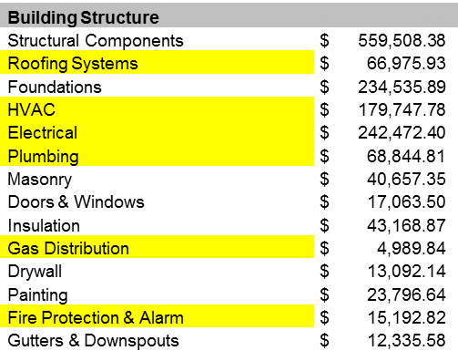
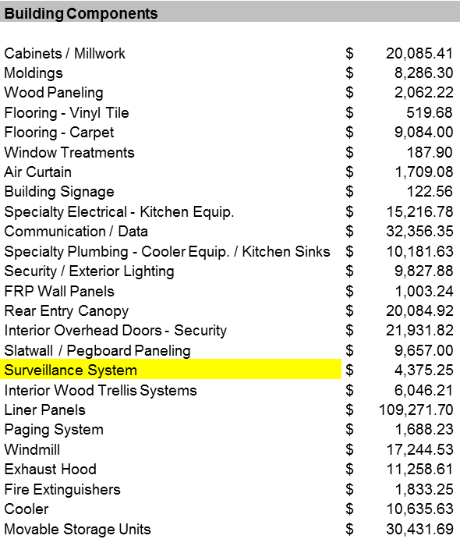
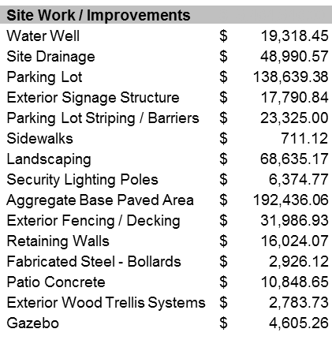
Stay Compliant, Maximize Deductions
The Capital vs. Expense Decision
Exp/cap test: Client spends $28,000 on repairing the roof.
TPR ratio test is 30%-35% (40% for roof).
28,000/66,975 = 42%.
TPRs say capitalize.
Spend $70,000 on electrical rewire.
Ratio test is 30%-35%
70,000/242,472 = 29%.
TPRs say expense.
Notes:
Warren

Slide 24
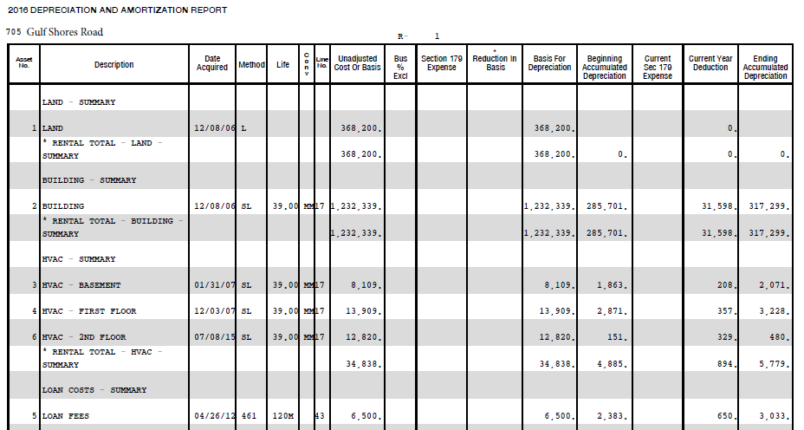
Look Back at Capital to Expense Reversals
Ballpark = $29,059 remaining in depreciation
$29,059 x 37% tax rate = $10,752 cash/tax benefit
Notes:
Warren

Slide 25
Cost Segregation is a Key Strategy for the CARES Act, Bonus Depreciation and the TPRs
TPR works best with calculated component cost detail allowing a better opportunity to make the EXPENSE DECISION.
TPRs
TCJA
CARES Act
Cost Segregation
Cost Segregation identifies assets with life eligible for bonus depreciation and acceleration.
QIP contribute to lower taxes and potential refund.
Solid Foundation: comprised of an engineering-based Cost Segregation study; provides detail components, units of property, building systems, major structural components.
Notes:
Warren

Slide 26
What is Cost Segregation?
Cost Segregation = Cash Flow
The process of analyzing and identifying commercial building components that are eligible for accelerated depreciation
Result is lower income taxes
An input calculation to the U.S. Tax Code – Building Systems Valuation
Allows building owners to use cash today instead of leaving it with the government for 39 years – time value of money
Personal property is segregated from real property
Benchmark: $30K-$80k per $1 Million in cost over five years
Buildings or tenant improvements as small as $200,000 in cost
Notes:
Jerry - Time VALUE of MONEY – A dollar today is worth more than in 15 years – If you won the lottery, ….

Slide 27
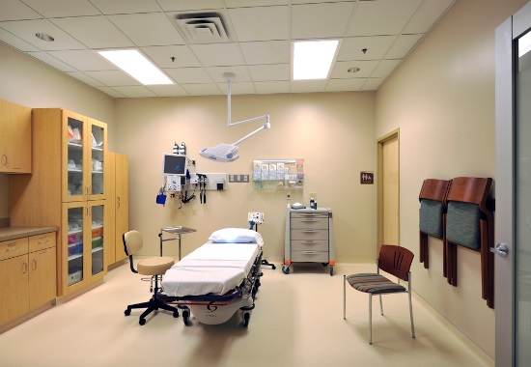

What is Cost Segregation?
Items that can be Accelerated
5- 7- & 15-Year QIP Property
Decorative building elements, wall coverings
Special electrical, plumbing and mechanical
Carpet, flooring, decorative molding
Built in cabinets and counter tops
Interior doors, moveable wall partitions
Security, decorative and special lighting
Window treatments and coverings
Communications, cable
Kitchen fixtures, refrigeration equipment
Notes:
Jerry

Slide 28
What is Cost Segregation?
Items that can be Accelerated
High Performance
Accelerated Depreciation
15-Year Property
Landscaping/Hardscaping
Paving
Fencing
Parking lot
Signage
Sidewalks
Irrigation
$180,000
$160,000
$140,000
$120,000
$100,000
$80,000
$60,000
$40,000
$20,000
5 years
100% Bonus Depreciation
Notes:
Jerry

Slide 29
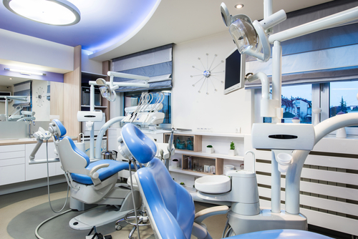
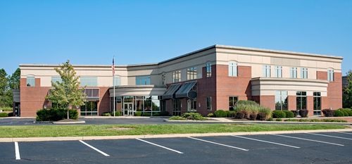
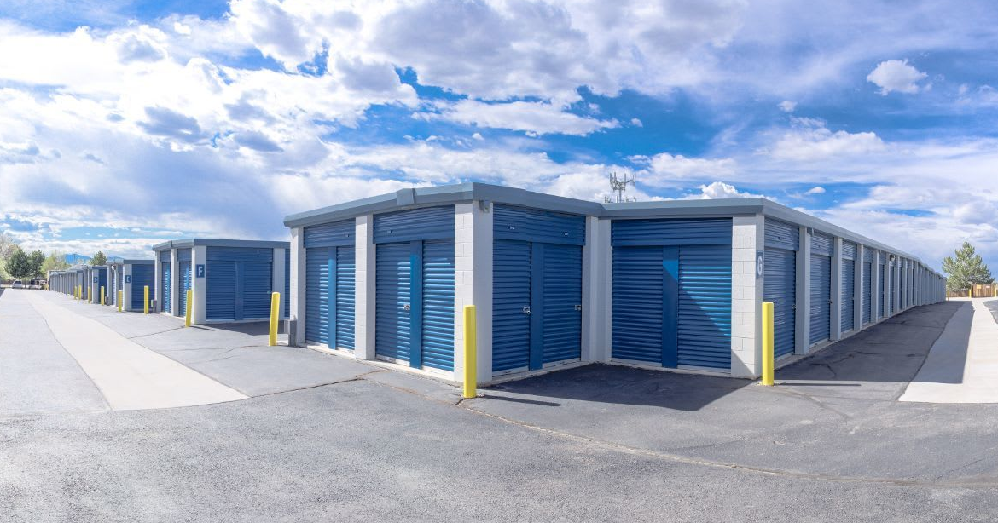
Cost Segregation: Case Studies
Multiple Office Complexes
12 Locations
Some purchased as far back as 1999
Previously owned older properties
Created a $5.3 Million deduction
Tax savings of $2,111,774
Self Storage
2017 purchase: $859,842
Non-climate control
Tax savings of $45,981
2018 construction: $3.6M
Climate control
Tax savings of $569,235
Dental Office
2008 Purchase: $1 Mill
Improvements: $450,000
Tax savings of $73,969
Notes:
Jerry

Slide 30
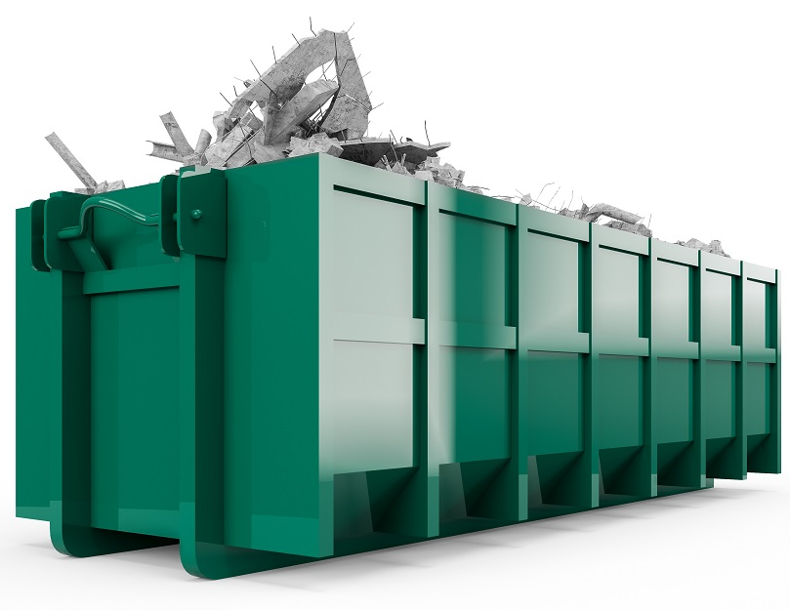
Partial Asset Disposition Election
Ability to write off assets that are no longer in use
Renovations, remodels, and replacements
Abandoned in place
Common items – roofs, HVAC, electrical
Retirement of a structural component of or improvement to a building
LED Retrofit Projects
Partial Asset Dispositions must be taken in the same year as the renovation
Tax savings at sale of property = decreases taxable personal property
Action: Did you renovate this tax year?
Notes:
Jerry - CASH FOR TRASH - MUST BE IN-SERVICE in EARLIER YEAR before improvements are made

Slide 31
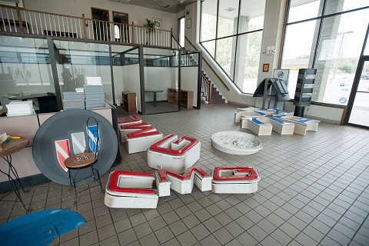
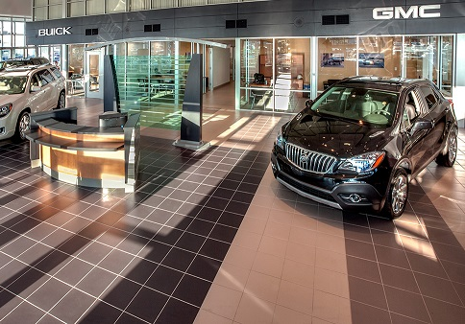
2014 Repair Regulations – Owned at Least a Year
Partial Asset Disposition Case Study with Cost Segregation
Auto Dealership Renovation Tax Savings
 | Original Building | Demolition | Renovation
Cash Flow | $134,718 | $53,297 | $126,243
Total Tax Savings |  | $314,240
Notes:
Jerry

Slide 32
2017 Tax Cuts and Jobs Act
More Deductions for Your Clients
100% Bonus Depreciation for properties purchased or built after September 27, 2017
CARES Act change: Any Qualified Improvement Property (now defined as 15-year) placed in-service after 9/27/2017 is eligible for 100% Bonus Depreciation.
New purchase, new construction, addition, or renovation
The assets must have a depreciable life of less than 20 years
Cost Segregation Studies identify 5-, 7-, & 15-year assets within buildings
Benchmark: $30K-$80k per $1Million in cost in first year
Pennsylvania does not allow Bonus on the state level but does allow clients to capture Bonus on a federal level
Notes:
Jerry - Warren likes to say - The combination of the TPRs, TCJA and CARES act create the “PERFECT STORM for tax savings.

Slide 33
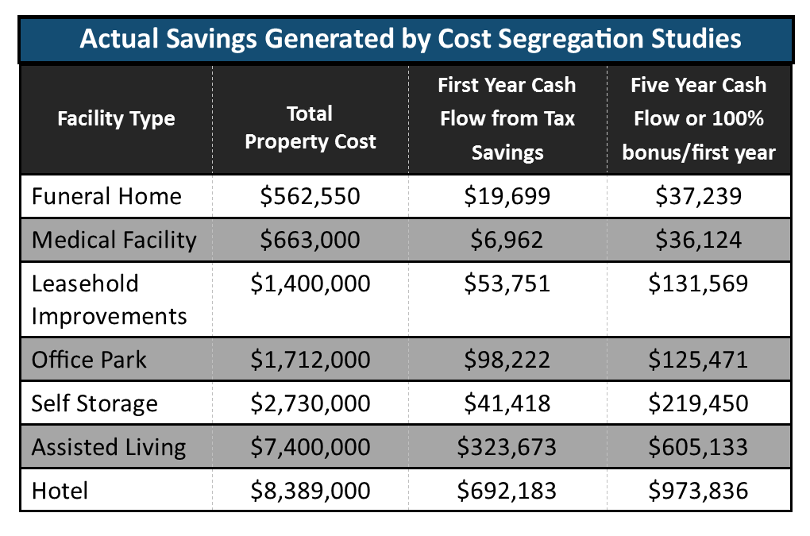
Cost Segregation: Continues to Provide Catch Up
Benefit Before and After 2017 Tax Reform (TCJA)
Notes:
Jerry - I’ll turn it back over Warren to tackle the 179 deduction and a few final comments

Slide 34
Section 179
5 & 7 Year Assets
15 Year QIP
Improvements - Roofs, Heating, ventilation, and air-conditioning property, Fire protection and alarm systems. Security systems.
All of the 5 & 7 year personal property generated in a Cost Segregation Study qualifies for Section 179
Notes:
Warren

Slide 35
I already filed Taxes! Can My Client Still Benefit?
Scenario : Owned the building prior to 2021 and previously filed taxes on it
Requires a 3115 change of accounting method from. (#7 Cost Seg; #21 removal)
3115 must be applied to a timely filed return
Can apply if within 6 months of original filing due date
Automatic Extension (Rev Proc. 2011-14)
ACTION
Engage a Cost Segregation Study, QIP, Section 179
Applications:
Reduce 2022 quarterly estimates
Apply to 2021 return with a 3115 change of accounting form
Notes:
Warren

Slide 36
Additional Thoughts / Concerns
Planning to sell soon?
Recapture
1031 Exchanges
Use Cost Segregation to continue to defer like a 1031 exchange
How does this affect Capital Gains?
We’ve already done this!
Does this open us up to audit?
Notes:
Warren

Slide 37
Current Administration’s Tax Plan
More Audits on the Way?
Expand IRS oversight of tax preparers
Expand funding for audits
$80 Billion over 10 years
Banks to report more on account flows
$700 billion over 10 years
Need for engineering-based cost seg firms like CSSI to back you up!
Let us take on the CS burden
CSSI’s Track Record
Notes:
Warren

Slide 38
Current Administration’s Tax Plan
Changes to Bonus Depreciation
Repeal TCJA
Not likely but Bonus would end after 2019 and 15 year QIP goes away
Leave alone –
100% ends in 2022 and phase out 20% yearly until expiration after 2026
Other Variations
Reduce to 50% bonus new and used property
Reduce to 50% bonus and only new construction
Retroactive to 2020 / 2021? Not likely for 2020.
Notes:
Warren

Slide 39
Current Administration’s Tax Plan
1031 Exchange
Biden proposes 1031 Exchange elimination
Currently for 2020 available and you have a 15% pass-through for personal tangible property.
Strategy: without 1031 exchange. Sell a building. Immediately buy new and Cost Seg it to defer ordinary income and capital gains.
Notes:
Warren

Slide 40
How to Get Started with CSSI
Let us Provide a No-Cost Predictive Analysis!
For the most accurate analysis, provide a depreciation schedule or a few data points:
Type of Building
Cost (without land)
Year and month acquired
Address
CSSI will generate an analysis at no-cost with fixed fee and potential savings.
We will work with you and your CPA to complete the work.
Notes:
Jerry

Slide 41
Action Items
Review clients for the TPRs especially new clients you may have picked up from other CPA firms.
Put into effect the repair regs to maximize repairs that can be expensed.
Scrub schedules – for Cap Ex, potential cost seg on building or improvements
Review your clients with renovations for QIP since 1/1/2018.
Review clients with Renovations for Partial Asset Disposition in current taxable year
Review clients with buildings for a Cost Segregation study to reduce taxes or defer.
Notes:
Jerry - A reputable Cost Seg Firm can do THE SCRUBBING

Slide 42
Questions ?
Jerry Lotz
CSSI National Account Manager
410-960-8269
Notes:
Jerry Close out - Thank you again to the Society for the opportunity, to WARREN and to YOU for coming

Slide 43
Thank You for Joining Us Today!
Jerry Lotz
Savings Advisor
CostSeg Energy Solutions
410.960.8269
jlotz@costseges.com
costseges.com
Warren Dazzio
Executive Vice President
CSSI – Cost Segregation Services, Inc.
225.241.9823
dazziow@costsegserv.com
costseges.com
WD.CSSIstudy.com

